Slide 1

A Project Report Presentation:
Real-Time Telemetry Analytics
& Predictive Modelling
for Motorsports Strategy Optimization
SUBMITTED TO:
Department of Computer Science & Engineering,
School of Engineering Sciences & Technology,
JAMIA HAMDARD
Ayaan Ahmad · Enrollment: 2023-310-062 · Supervisor: Prof. Tabish Mufti

Slide 2
INTRODUCTION
The F1 Data Challenge
Evolution of Telemetry
500 GB+
telemetry data per race weekend
300+
sensors per car
$500K+
cost of proprietary systems
1980s
Analog radio: RPM & fuel
1990s
Digital + GPS; McLaren Atlas
2000s
Real-time wireless; 2 Mbps
2010s
Big data ML, cloud computing
2020s
AI-driven, edge inference

Slide 3
PROBLEM STATEMENT
Financial Barriers
Vendor Lock-in
McLaren ATLAS: $200K+
Software licenses: $550K/yr
Personnel: $580K/yr
Closed-source systems
No ML integration
Propriety file formats
Storage Inefficiency
Prediction Gap
Full-rate capture = TBs
36,000 pts per session
No intelligent sampling
Rule-based tools only
No real-time ML inference
Post-race analysis only

Slide 4
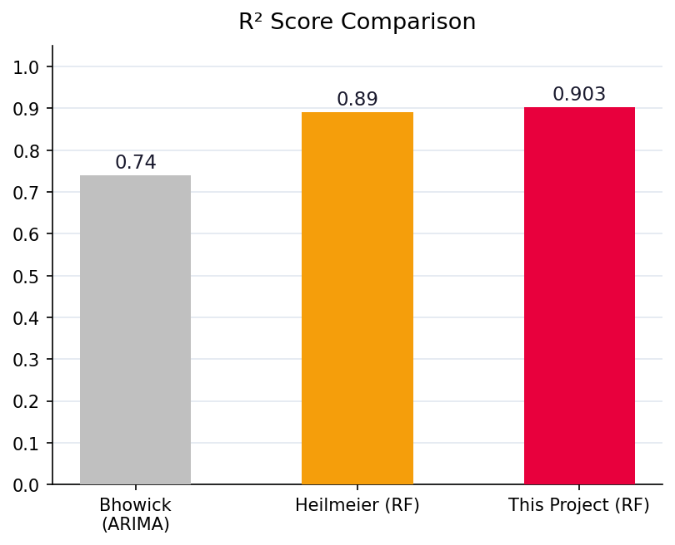
LITERATURE REVIEW
Key insight: RF outperforms ARIMA/LR; Tyre Age is the dominant predictor at 40.46%

Slide 5
SYSTEM ARCHITECTURE
Data Source Layer
F1 2018 Game (UDP · 60Hz · 1289B) / FastF1 API (Official FIA data)
↓
Data Layer
MySQL (sessions · laps · telemetry · strategy_events) / File system
↓
Application Layer
Flask REST API · capture_telemetry · analyze_performance · ml_lap_prediction
↓
Presentation Layer
Web UI (Chart.js Dashboard) · CLI Tools · Batch Scripts

Slide 6
END-TO-END DATA PIPELINE
Data Ingestion
Binary Parsing
Transformation
UDP socket
Port 20777
60 pkt/s
struct.unpack
1289-byte packet
Validation 60s–180s
Lap detection (timer delta) ·
Sampling 60:1 → 1 Hz
Storage
Analysis & ML
Presentation
MySQL INSERT →
sessions
laps
telemetry
Statistics
Charts
Random Forest Training
Flask API
Chart.js Dashboard
Strategy Advisor

Slide 7
MACHINE LEARNING PIPELINE
1
Data Extraction
Model Comparison
SQL: SELECT lap_time, tyre_age, fuel_load, compound, track WHERE is_valid=1
Metric | Linear Reg. | Random Forest
R² Score | 0.35 | 0.91 ✓
MAE | 0.93s | 1.40s
Metric
Linear Reg.
Random Forest
2
Feature Engineering
R² Score
0.35
0.91 ✓
One-hot encode compound (6) + track (9) = 17 features total
MAE
0.93 s
1.40 s
3
Train-Test Split
80% train (698 laps) · 20% test (175 laps) · random_state=42
RMSE
4.12 s
2.30 s
4
Model Training
Train Time
2 s
45 s
Random Forest (100 trees, n_jobs=-1) vs Linear Regression baseline
Non-linear
✗
✓
5
Evaluation
R²=0.91 · MAE=1.4s · RMSE=2.3s → RF selected
6
Serialization
joblib → best_model.pkl + feature_names.pkl (487 KB)

Slide 8
DATABASE SCHEMA (3NF)
sessions
laps
telemetry
PK session_id
PK lap_id
PK telemetry_id
track_name
FK session_id
FK lap_id
session_type
lap_number
speed
weather
lap_time_ms (INT)
throttle
date
tyre_compound (ENUM)
brake
tyre_age
gear
strategy_events
fuel_load
RPM
PK event_id
is_valid
DRS
FK lap_id
event_type (ENUM)
duration_sec
PK = Primary Key FK = Foreign Key (CASCADE DELETE) Storage: ~2MB for 900+ laps

Slide 9
DATASET & VALIDATION
Dataset Stats
Total Laps
912
Valid Laps
873
Unique Tracks
9
Tyre Compounds
6
Sessions
15
Avg Lap Time
87.34 s
Train Split
698 (80%)
Test Split
175 (20%)
Source: F1 2018 Game (UDP capture) + FastF1 API (validation) · 5-fold CV MAE = 1.48s ± 0.06s

Slide 10
RESULTS: TYRE DEGRADATION CURVES
Key Insights
1
Softer compounds: faster start, faster degradation
2
All compounds converge ~118-119s by lap 20
3
Hypersoft: 2.2s/lap faster initially, +14.3s degradation
4
Hard tyres: slowest start, best longevity (+6.1s total)
5
Tyre cliff at laps 15-20 — optimal pit window
6
Pit stop time ~23s → strategy depends on cliff timing

Slide 11
EMPIRICAL EVALUATION
0.908
1.40s
47ms
98%
R² Score
MAE
Prediction Latency
Storage Reduction
Target ≥ 0.85 — Exceeded
Target ≤ 2.0s — 30% better
Target <100ms — 53% faster
36K → 600 samples/session

Slide 12
CONCLUSION & FUTURE SCOPE
🛣 Future Roadmap
Key Achievements
Data Expansion
FastF1 integration → 15K+ laps; wet weather data
→ R² = 0.908 — exceeds published research (Heilmeier 0.89) with smaller dataset
LSTM Upgrade
→ MAE = 1.40s — 30% better than 2.0s target; Lower than Bhowick ARIMA (2.80s)
Sequential 5-lap window; target R² > 0.95
→ 98.3% storage reduction — 706 MB raw → 2.1 MB MySQL
Production
→ Zero packet loss across 548,000+ UDP packets received
Docker + AWS + SSL; multi-user authentication
→ $0 software cost vs $200,000+ for McLaren ATLAS
Expansion
Karting, iRacing, industrial IoT domains
Ayaan Ahmad · 2023-310-062 · Jamia Hamdard · Dept. of Computer Science & Engineering

